Slide 1
HW4
TA 余孟倫、王菱君
Due date: 2024/1/12 23:59

Slide 2
Outline
Introduction
Grading Policy
Part1
Part2
Part3
Part4
Rules & Penalty
Reference

Slide 3
Introduction
You are asked to build a Live Streaming Server and perform tasks using deep learning model.
You can team up with at most 3 people doing this project.
Overall architecture
Streaming SERVER
Client
Listen
tracking
Segmenter
HTTP
Client
Respond
Client
Camera
Notes:
這次的作業主要是去做一個live streaming server，然後使用dnn去完成某些指定的任務，所以簡單來說它就會是一個經過影像處理的live streaming server
那這次作業最多可以三人一組，
接下來，我們來看一下這次作業的整體架構，首先會先經由相機獲得實時的影像，在經過DNN去做tracking，再將output經過壓縮裁切成多段的segmenter，最後在經過http protocol發送給client端
，讓使用者透過browers去瀏覽結果

Slide 4
Introduction
You can create live streaming in this way.
DNN model output
Segments (.ts)
Index file (.m3u8)
HTML
View in a browser
Encoder & Segmenter
(ffmpeg)
tagged
Notes:
接下來介紹一下你們可以通過甚麼方式傳送影像，這是經過壓縮的版本，需要將outpu利用ffmpeg壓縮後transpose成兩種不同的檔案，分別是ts跟m3u8，接下來再把這些檔案tag到html就能撥放了

Slide 5
Grading Policy
Part1:
Live Streaming _{(35 points)}
Part2:
Deep Learning Model _{(30 points)}
Part3:
Extensions _{(20 points)}
Part4:
Demo_{(15 points)}
We will check the Part1, Part2, Part3 in the demo.

Slide 6
Part1
Part 1 Live Streaming (30 points)
You can use any tool to build your streaming server, such as python http.server, flask, etc.
Directly using Twitch, YouTube, Live house, or OBS is NOT allowed.
Note that
The encoded file must be a LIVE video segment, thus you will need a camera.
You should avoid large latency. (<1 sec)

Slide 7
Part2
Part 2 Deep Learning Network (30 points)
Use a deep learning network to achieve this part.
Object Tracking
You can use any tracking model
or use TransTrack
https://github.com/PeizeSun/TransTrack

Slide 8
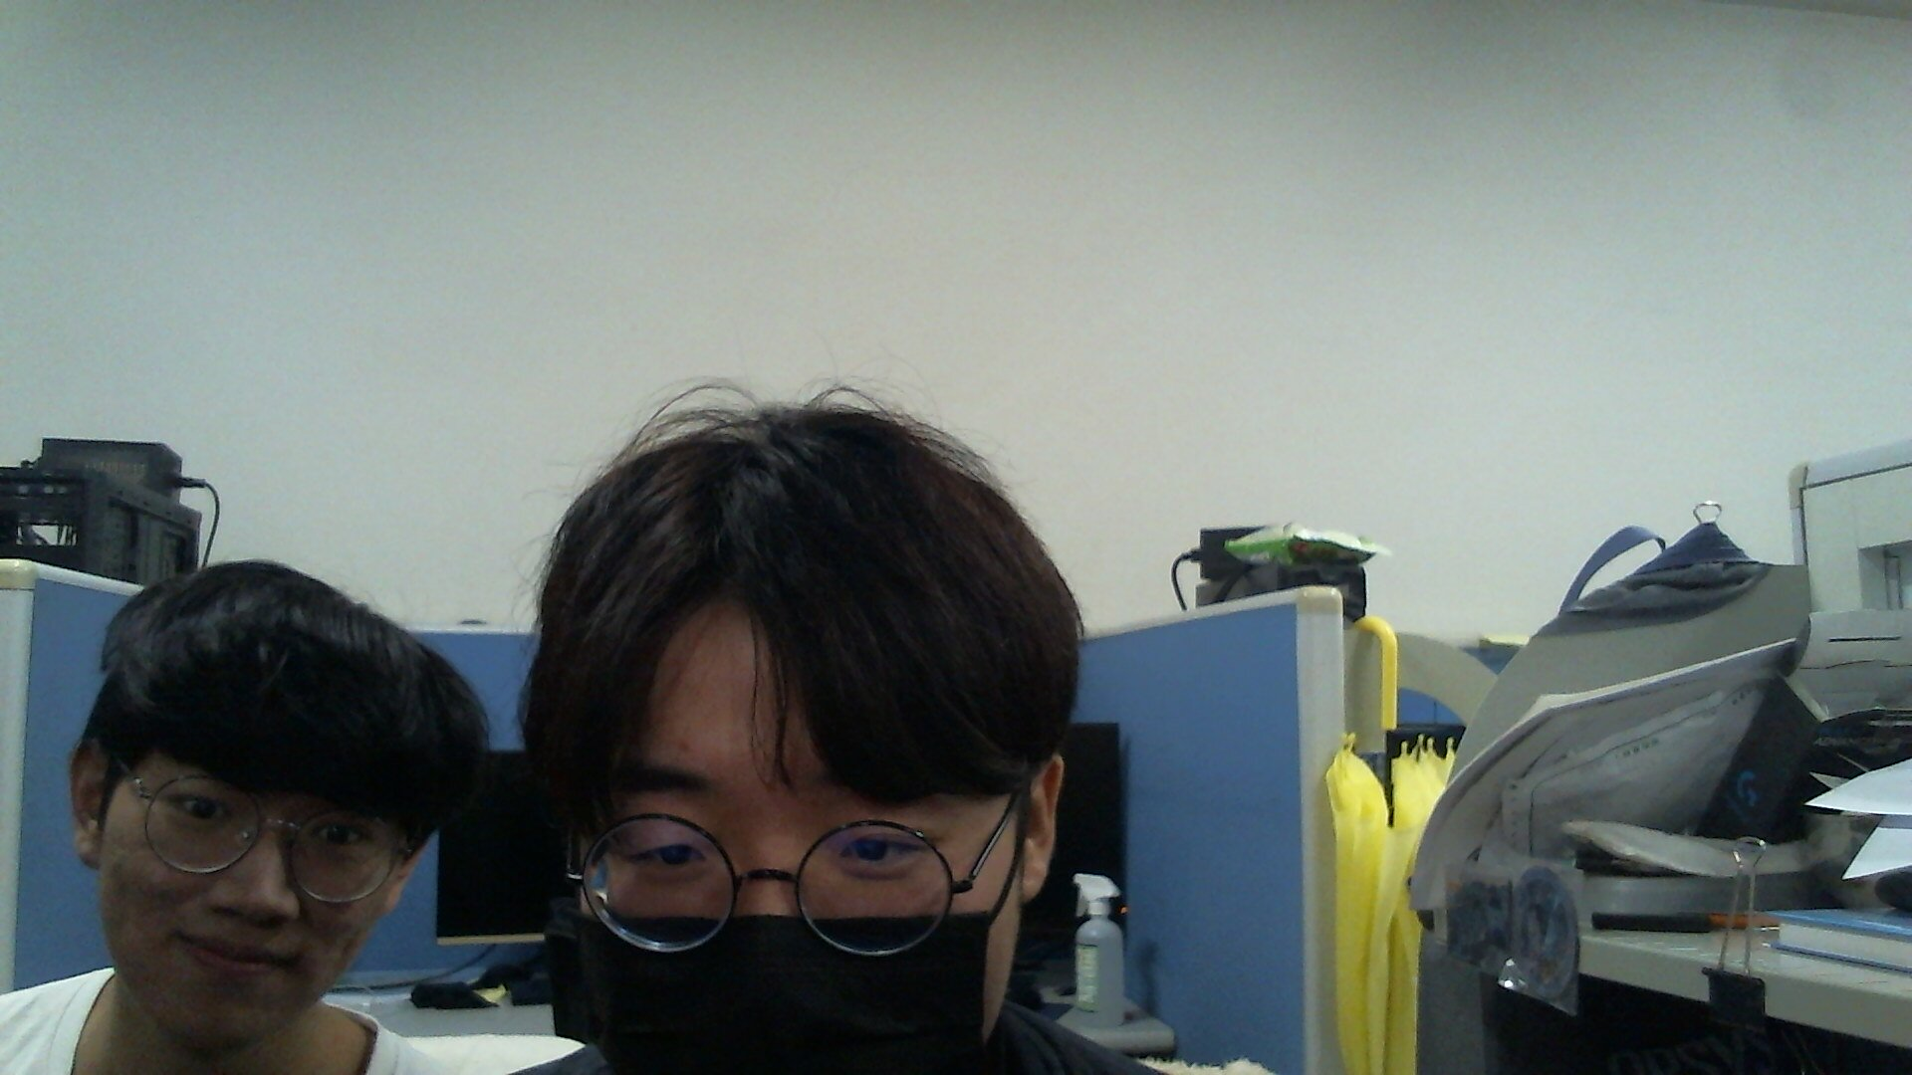
Part3
Part 3 Extensions (20 points)
You should provide a user interface (e.g., mouse) to specify objects to track.
User can choose one or multiple objects on the screen to track
→ the tracked objects are enclosed with bounding boxes
User can cancel the selection of any object that is currently under tracking.
Note
You can use javascript to get the mouse coordinate and use flask to pass to python.
Click !!

Slide 9
Part3
Click !!

Slide 10
Part4
Part 4 Demo(15 point)
Write a report to introduce your architecture or modify. (less than 2 pages)
Make a simple presentation for us using the report. For example , “tell me how to combine tracking models with live streaming” or “tell me about your changes for the transtrack code.”
We will ask some questions from your presentation, report and code.
We will have DEMO during 1/8-1/12 at EC637.
Please go to Google sheet and fill demo time you prefer.

Slide 11
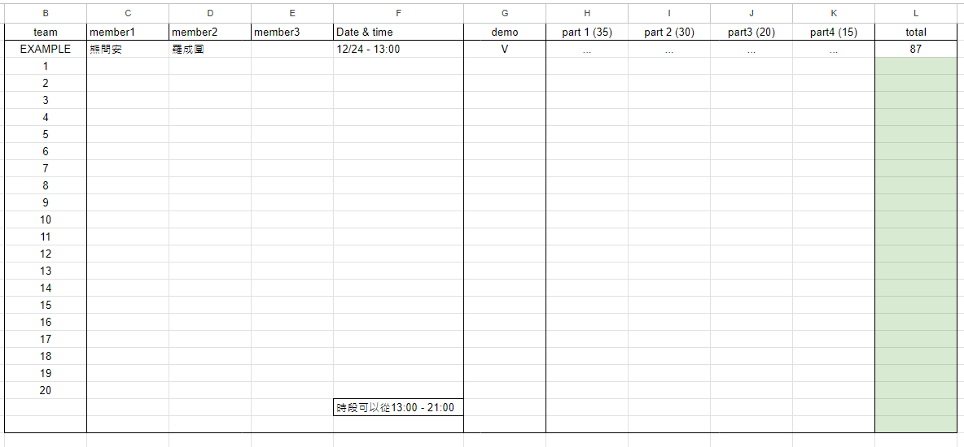
Part4
Part 4 Demo(15 point)
Write a report to introduce your architecture or modify. (less than 2 pages)
Make a simple presentation for us using the report. For example , “tell me how to combine tracking models with live streaming” or “tell me about your changes for the transtrack code.”
We will ask some questions from your presentation, report and code.
We will have DEMO during 1/8-1/12 at EC637.
Please go to Google sheet and fill demo time you prefer.

Slide 12
Rules & Penalty
Submission
Source code
Web server (streaming) related code (e.g. flask, html, javascript)
Deep learning related code (except model weight)
Zip these into a folder name “teamID.zip”, and then upload to E3 before Demo.
Penalty
Late penalty – 20% per day
1 day => 80%, 2days => 60%.....
Notes
One submission for a team before demo.
You will lose points for any violation or incomplete requirement.
If there is any question, please contact us via E3.
Good Luck!

Slide 13
Reference
Transtrack
https://github.com/PeizeSun/TransTrack
Flask
https://flask.palletsprojects.com/en/3.0.x/
https://dormousehole.readthedocs.io/en/latest/
HTML mouse event
https://www.delftstack.com/zh-tw/howto/javascript/javascript-mouse-position/
ffmpeg-python
https://github.com/kkroening/ffmpeg-python
https://kkroening.github.io/ffmpeg-python/
ffmpeg-python-streaming
https://github.com/hadronepoch/python-ffmpeg-video-streaming

Slide 14
Reference
Never_loses
https://www.twitch.tv/never_loses
Roger9527
https://www.twitch.tv/roger9527

